Slide 1

Introduction to Data Analytics
ITE 5201
Lecture5-Data Visualization-2

Slide 2

Statistical concepts of classification of Data
Classification is the process of arranging data into homogeneous
(similar) groups according to their common characteristics.
Raw data cannot be easily understood, and it is not fit for further analysis and interpretation. Arrangement of data helps users in comparison and analysis. It is also important for statistical sampling.
Copyright © 2018 Pearson Education, Inc. All Rights Reserved.

Slide 3
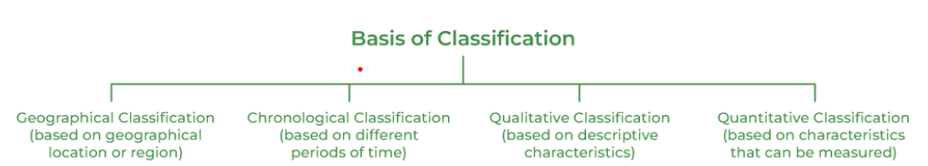
Classification of Data
Copyright © 2018 Pearson Education, Inc. All Rights Reserved.

Slide 4
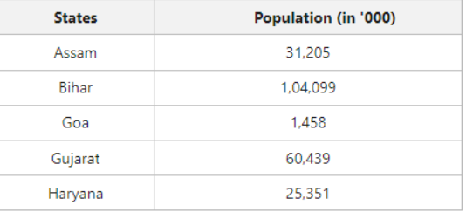
Classification of Data
Geographical classification
When data are classified on the basis of location or areas, it is called geographical classification
Copyright © 2018 Pearson Education, Inc. All Rights Reserved.

Slide 5
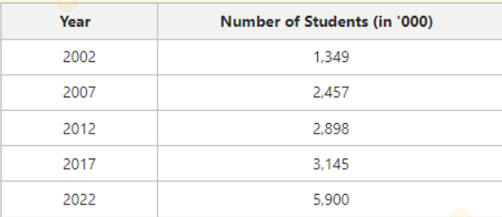
Classification of Data
Chronological classification
Chronological classification means classification on the basis of time, like months, years etc.
Copyright © 2018 Pearson Education, Inc. All Rights Reserved.
Notes:
https://www.geeksforgeeks.org/basis-of-classification-of-data/?ref=lbp

Slide 6
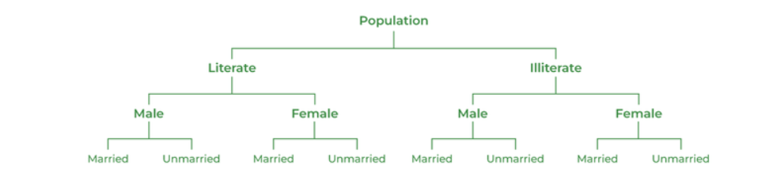
Classification of Data
Qualitative classification
In Qualitative classification, data are classified on the basis of some attributes or quality such as gender, colour of hair, literacy and religion. In this type of classification, the attribute under study cannot be measured. It can only be found out whether it is present or absent in the units of study.
Copyright © 2018 Pearson Education, Inc. All Rights Reserved.
Notes:
https://www.geeksforgeeks.org/basis-of-classification-of-data/?ref=lbp

Slide 7
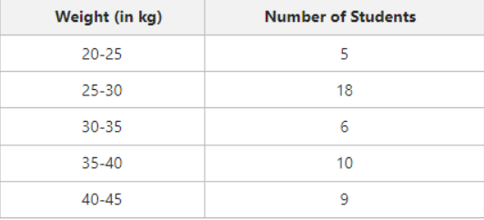
Classification of Data
Quantitative classification
Quantitative classification refers to the classification of data according to some characteristics, which can be measured such as height, weight, income, profits etc.
Copyright © 2018 Pearson Education, Inc. All Rights Reserved.
Notes:
https://www.geeksforgeeks.org/basis-of-classification-of-data/?ref=lbp

Slide 8
Quantitative classification
In quantitative classification there are two elements
variable
Variable refers to the characteristic that varies in magnitude or quantity. E.g. weight of the students. A variable may be discrete or continuous.
Frequency
Frequency refers to the number of times each variable gets repeated. For example there are 50 students having weight of 60 kgs. Here 50 students is the frequency.
Copyright © 2018 Pearson Education, Inc. All Rights Reserved.
Notes:
Discrete: The number of students in a college is a discrete variable as they cannot be expressed in fractions. Continuous:The height of students in a class is a continuous variable as they can be measured in numbers as well as in fractions.

Slide 9
Frequency Distributions
After collecting data, the first task for a researcher is to organize and simplify the data so that it is possible to get a general overview of the results.
This is the goal of descriptive statistical techniques.
One method for simplifying and organizing data is to construct a
frequency distribution.
Copyright © 2018 Pearson Education, Inc. All Rights Reserved.

Slide 10
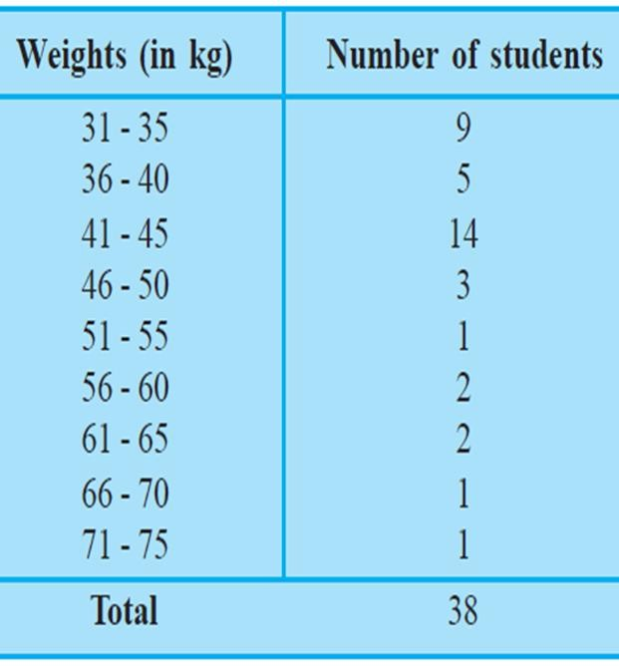
Frequency Distributions
The following technical terms are important when a continuous frequency distribution is formed
Class limits: Class limits are the lowest and highest values that can be included in a class. For example take the class 51-55. The lowest value of the class is 51 and the highest value is 55. In this class there can be no value lesser than 51 or more than 55. 51 is the lower class limit and 55 is the upper class limit.
Class interval: The difference between the upper and lower limit of a
class is known as class interval of that class.
Class frequency: The number of observations corresponding to a particular class is known as the frequency of that class
Copyright © 2018 Pearson Education, Inc. All Rights Reserved.

Slide 11
Frequency Distributions
A frequency distribution is an organized tabulation showing exactly how many individuals are located in each category on the scale of measurement.
A frequency distribution presents an organized picture of the entire set of scores, and it shows where each individual is located relative to others in the distribution.
In a frequency distribution graph, the score categories (X values) are listed on the X axis and the frequencies are listed on the Y axis.
Copyright © 2018 Pearson Education, Inc. All Rights Reserved.

Slide 12
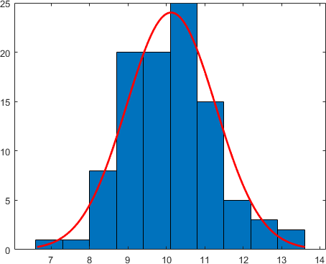
Histograms
A histogram shows a variable’s distribution as a set of adjacent rectangles on a data chart.
A graphical display of data using bars of different heights.
It is similar to a Bar Chart, but a histogram groups numbers into ranges.
Histograms represent counts of data within a numerical range of values.
Copyright © 2018 Pearson Education, Inc. All Rights Reserved.

Slide 13
Histograms and Bar graph
A
histogram represents the frequency distribution of
continuous variables.
A bar graph is a diagrammatic comparison of discrete variables.
Histogram presents numerical data whereas bar graph shows categorical data.
The histogram is drawn in such a way that there is no gap between the bars.
Copyright © 2018 Pearson Education, Inc. All Rights Reserved.

Slide 14
Smooth curve
If the scores in the population are measured on an interval or ratio scale, it is customary to present the distribution as a smooth curve.
The smooth curve emphasizes the fact that the distribution is not showing the exact frequency for each category.
Copyright © 2018 Pearson Education, Inc. All Rights Reserved.

Slide 15
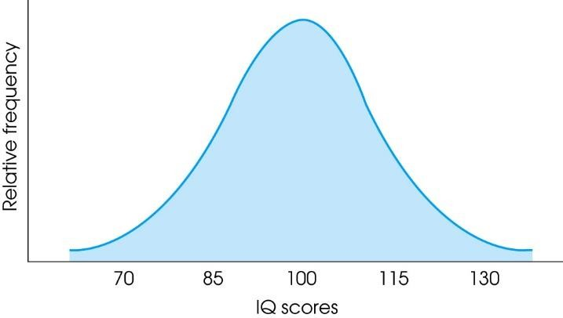
Shape
A graph shows the shape of the distribution.
A distribution is symmetrical if the left side of the graph is (roughly) a mirror image of the right side.
On the other hand, distributions are skewed when scores pile up on one side of the distribution, leaving a "tail" of a few extreme values on the other side.
Copyright © 2018 Pearson Education, Inc. All Rights Reserved.

Slide 16
Positively, Negatively Skewed Distributions
In a positively skewed distribution, the scores tend to pile up on the left side of the distribution with the tail points to the right.
In a negatively skewed distribution, the scores tend to pile up on the right side and the tail points to the left.
Copyright © 2018 Pearson Education, Inc. All Rights Reserved.

Slide 17
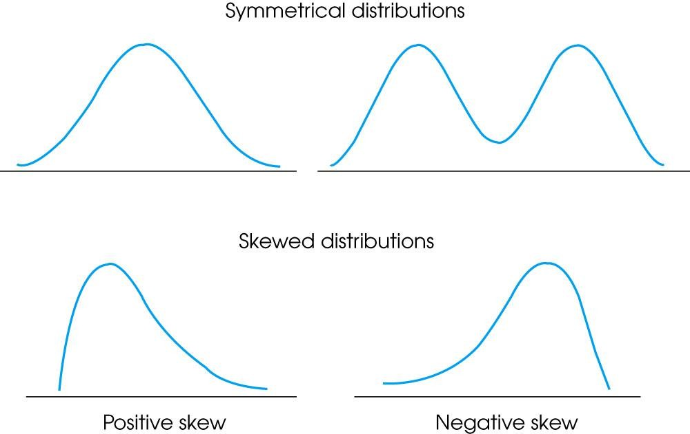
Positively, Negatively Skewed Distributions
Copyright © 2018 Pearson Education, Inc. All Rights Reserved.

Slide 18
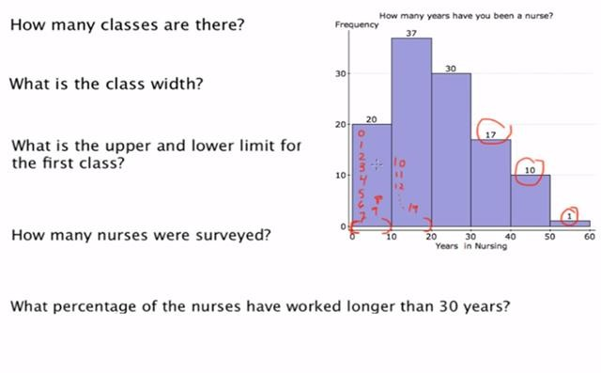
Example
Copyright © 2018 Pearson Education, Inc. All Rights Reserved.

Slide 19
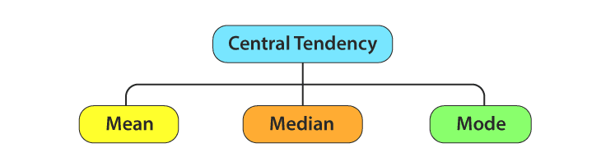
Measures of Centre Tendency
In statistics, the central tendency is the descriptive summary of a
data set.
Through the single value from the dataset, it reflects the centre of the data distribution.
Moreover, it does not provide information regarding individual data from the dataset, where it gives a summary of the dataset. Generally, the central tendency of a dataset can be defined using some of the measures in statistics.
Copyright © 2018 Pearson Education, Inc. All Rights Reserved.

Slide 20
Mean
The mean represents the average value of the dataset.
It can be calculated as the sum of all the values in the dataset divided by the number of values. In general, it is considered as the arithmetic mean.
Some other measures of mean used to find the central tendency are as follows:
Geometric Mean (nth root of the product of n numbers)
Harmonic Mean (the reciprocal of the average of the reciprocals)
Weighted Mean (where some values contribute more than others)
It is observed that if all the values in the dataset are the same, then all geometric, arithmetic and harmonic mean values are the same. If there is variability in the data, then the mean value differs.
Copyright © 2018 Pearson Education, Inc. All Rights Reserved.
Notes:
Geometric Mean = ⁵√(1 × 3 × 9 × 27 × 81) = 9, Geometric Mean of 2 and 18 = √(2 × 18) = 6,
Example: What is the harmonic mean of 1, 2 and 4?
The reciprocals of 1, 2 and 4 are:
11 = 1, 12 = 0.5, 14 = 0.25
Now add them up:
1 + 0.5 + 0.25 = 1.75
Divide by how many:
Average = 1.753
The reciprocal of that average is our answer: Harmonic Mean = 31.75 = 1.714 (to 3 places)

Slide 21
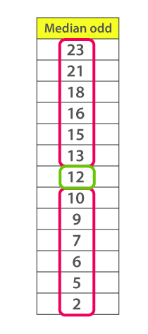
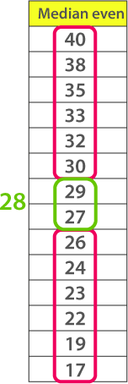
Median
Median is the middle value of the dataset in which the dataset is arranged in the ascending order or in descending order.
When the dataset contains an even number of values, then the median value of the dataset can be found by taking the mean of the middle two values.
If you have skewed distribution, the best measure of finding the central tendency is the median.
Copyright © 2018 Pearson Education, Inc. All Rights Reserved.

Slide 22
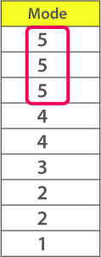
Mode
The mode represents the frequently occurring value in
the dataset.
Sometimes the dataset may contain multiple modes and in some cases, it does not contain any mode at all.
If you have categorical data, the mode is the best choice to find the central tendency.
Copyright © 2018 Pearson Education, Inc. All Rights Reserved.

Slide 23
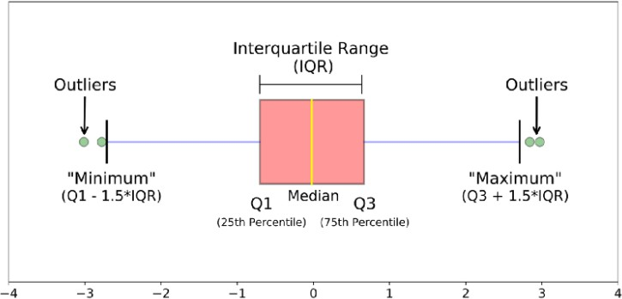
Box Plotting
The image above is a boxplot. A boxplot is a standardized way of displaying the distribution of data based on a five number summary (“minimum”, first quartile (Q1), median, third quartile (Q3), and “maximum”). It can tell you about your outliers and what their values are. It can also tell you if your data is symmetrical, how tightly your data is grouped, and if and how your data is skewed.
Copyright © 2018 Pearson Education, Inc. All Rights Reserved.

Slide 24
Statistical plots
Statistical plots allows viewers to :
Identify outliers
Visual distributions
Deduce variable types
Discover relationships and core relations between variables in a dataset.
Copyright © 2018 Pearson Education, Inc. All Rights Reserved.

Slide 25
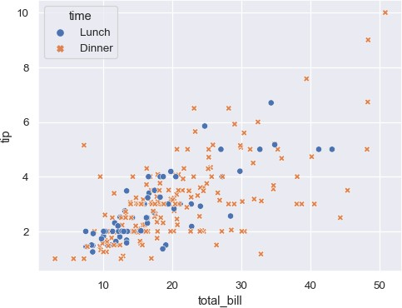
Scatter plots
Scatter plots are useful when you want to explore interrelations
or dependencies between two different variables.
These data graphics are ideal for visually spotting outliers and trends in data.
Scatter plots are used when you want to show the relationship between two variables.
Scatter plots are sometimes called correlation plots because they show how two variables are correlated.
Copyright © 2018 Pearson Education, Inc. All Rights Reserved.

Slide 26
Scatter plot
Direction:
Positive: as one variable increases so does the other. Height and shoe size are an example; as
one's height increases so does the shoe size.
Negative: as one variable increases, the other decreases. Time spent studying and time spent on video games are negatively correlated; as your time studying increases, time spent on video games decreases.
No correlation: there is no apparent relationship between the variables. Video game scores and shoe size appear to have no correlation; as one increases, the other one is not affected.
Form:
Linear
Nonlinear
Strength:
Weak
Moderate
Strong
Outliers
Copyright © 2018 Pearson Education, Inc. All Rights Reserved.

Slide 27
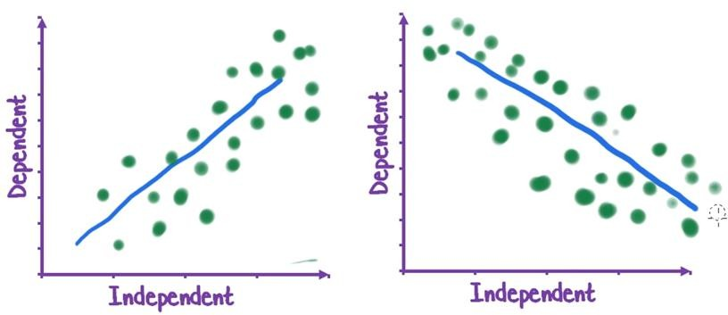
Direction
Positive
Negative
Copyright © 2018 Pearson Education, Inc. All Rights Reserved.

Slide 28
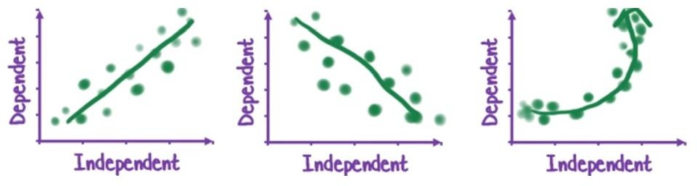
Form
Linear
Linear
Non-Linear
Copyright © 2018 Pearson Education, Inc. All Rights Reserved.

Slide 29
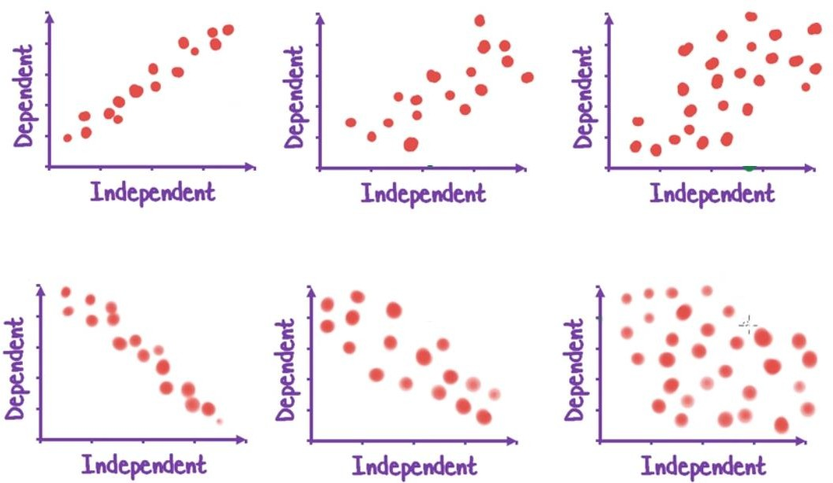
Strength
Strong
Moderate
Weak
Strong
Moderate
Weak
Copyright © 2018 Pearson Education, Inc. All Rights Reserved.

Slide 30
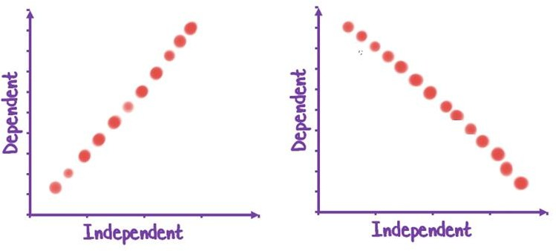
Strength-Perfect
Perfect
Perfect
Copyright © 2018 Pearson Education, Inc. All Rights Reserved.

Slide 31
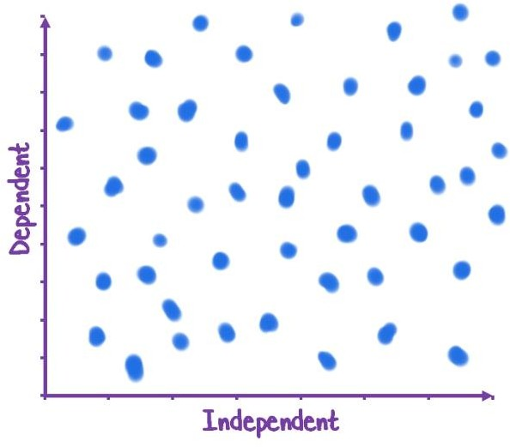
Strength-No association
No association
Copyright © 2018 Pearson Education, Inc. All Rights Reserved.

Slide 32
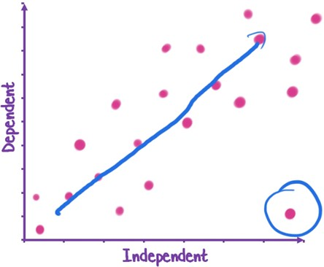
Outlier
Outlier
Copyright © 2018 Pearson Education, Inc. All Rights Reserved.

Slide 33
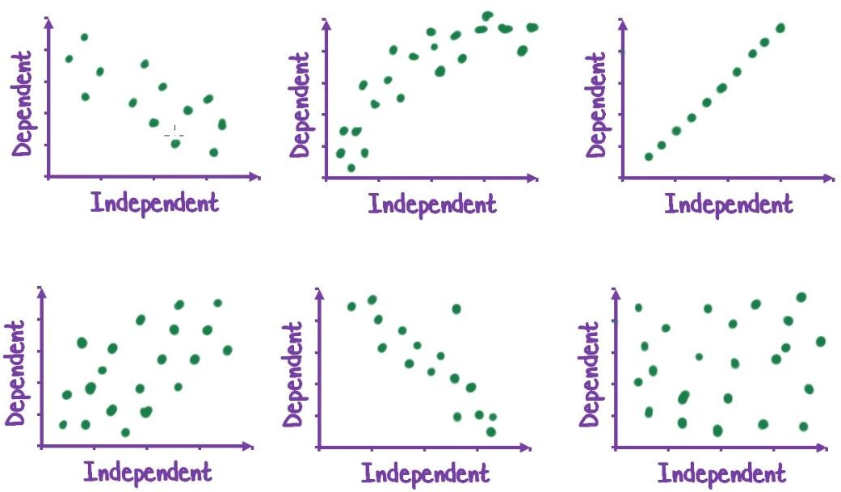
Example
Copyright © 2018 Pearson Education, Inc. All Rights Reserved.

Slide 34
Scatter plot Matrices
A scatterplot matrix is a collection of scatterplots organized into a grid (or matrix).
A scatter plot matrix can show how multiple variables are related.
After plotting all the two-way combinations of the variables, the matrix can show relationships between variables to highlight which relationships are likely to be important.
The matrix can also identify outliers in multiple scatter plots.
Copyright © 2018 Pearson Education, Inc. All Rights Reserved.

Slide 35
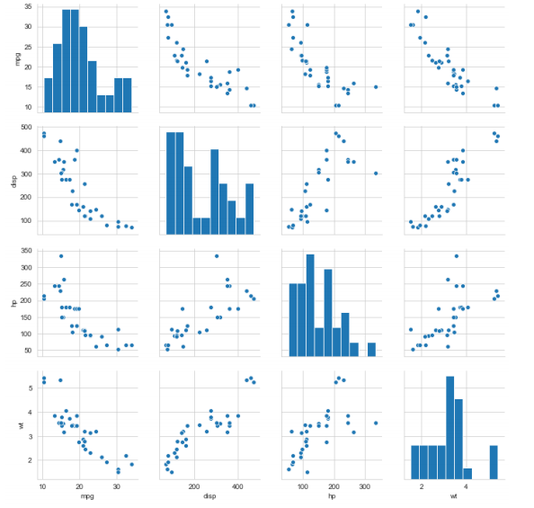
Scatter plot Matrices
Copyright © 2018 Pearson Education, Inc. All Rights Reserved.

